Slide 1
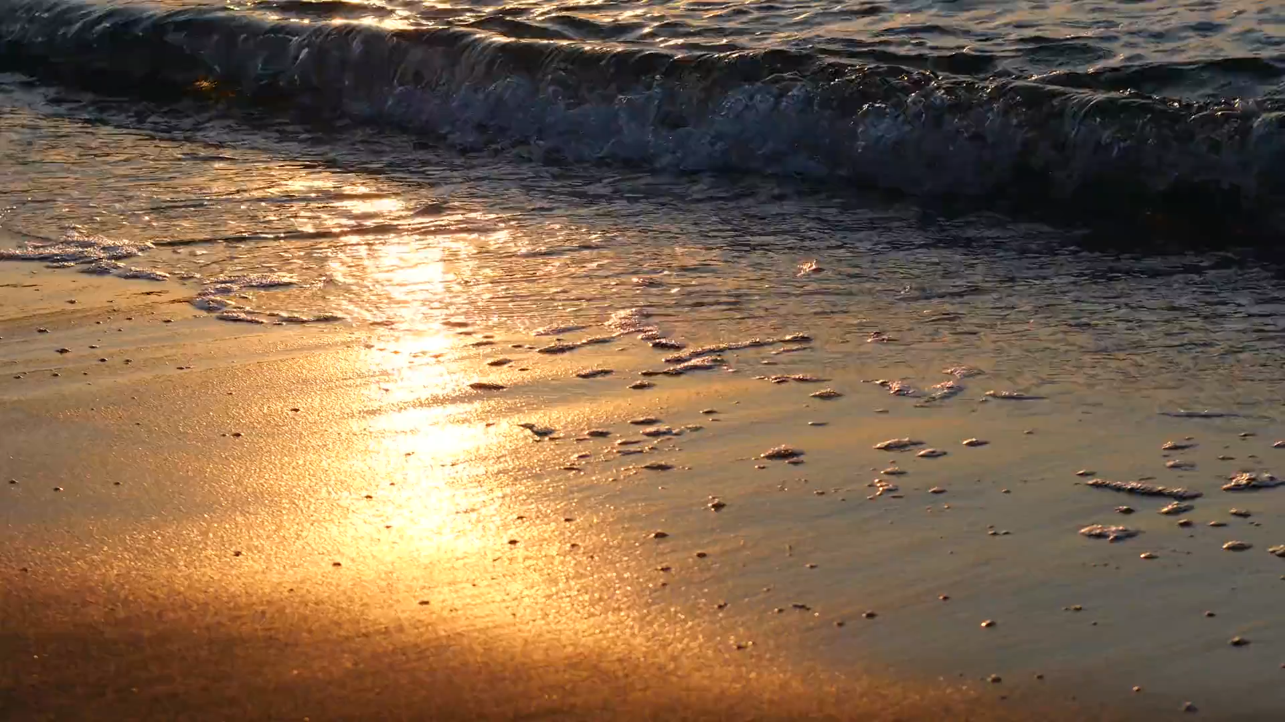

Slide 2
WATER
WATER

Slide 4
Smruti Ranjan Nayak
Smruti Ranjan Nayak

Slide 5

Hii I’m smruti, Welcome to my channel Beginners R Star. Plzz LIKE, SHARE & SUBSCRIBE
Hii I’m smruti, Welcome to my channel Beginners R Star. Plzz LIKE, SHARE & SUBSCRIBE

Slide 6

IDEA 1
IDEA 2
IDEA 3

Slide 7
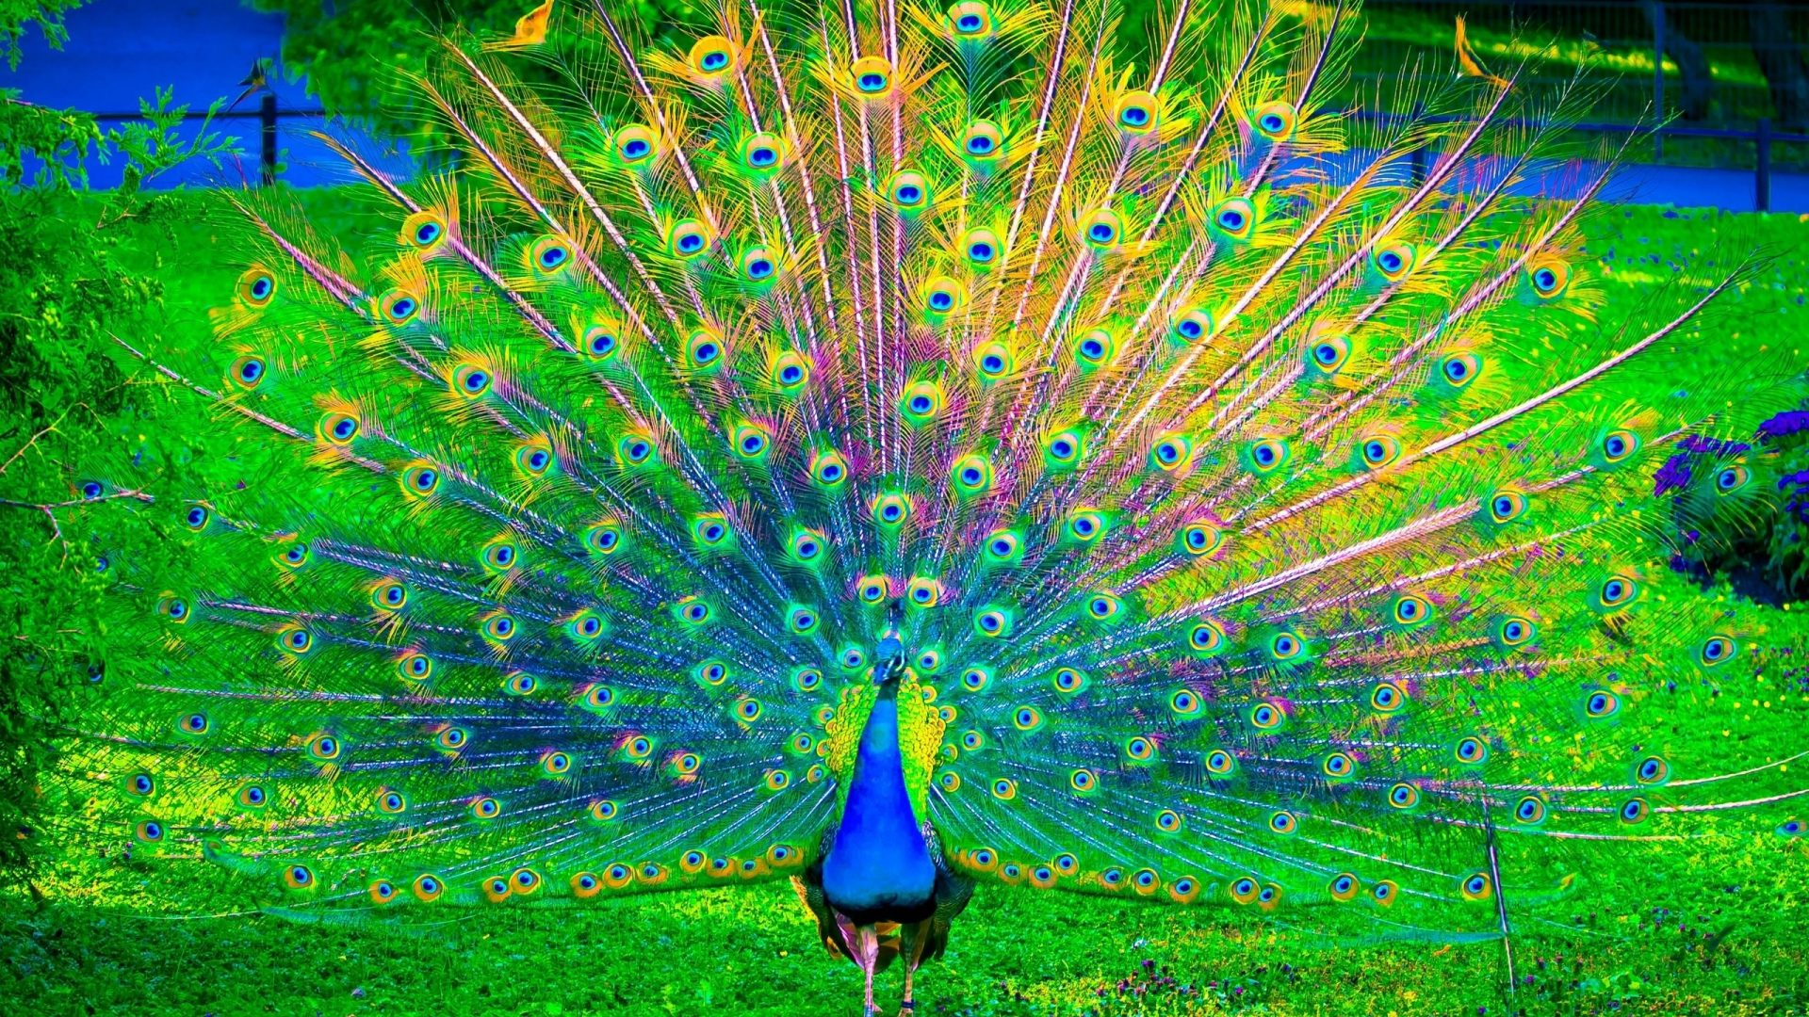

Slide 8


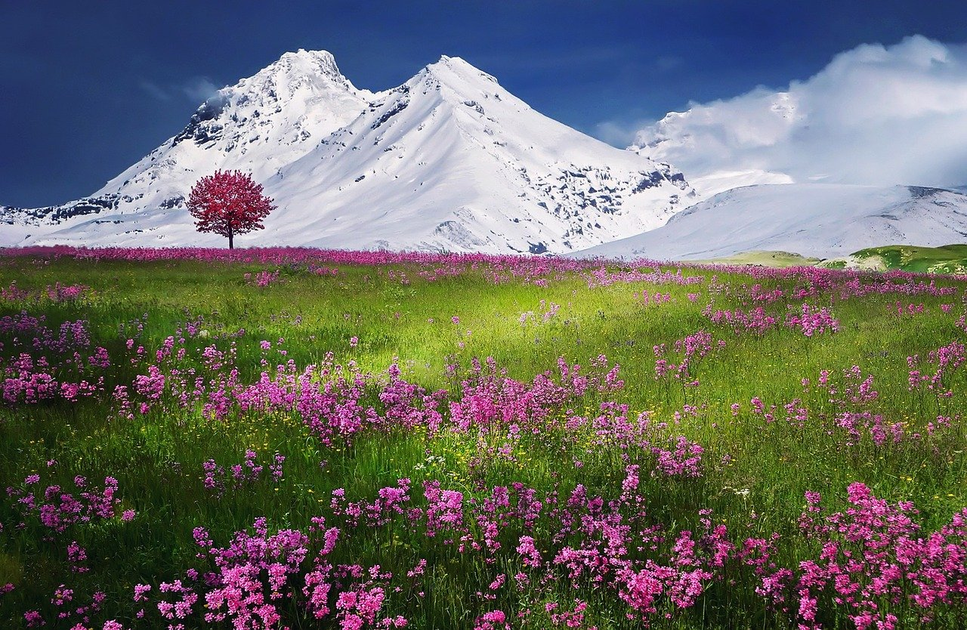

Slide 9



